Slide 1
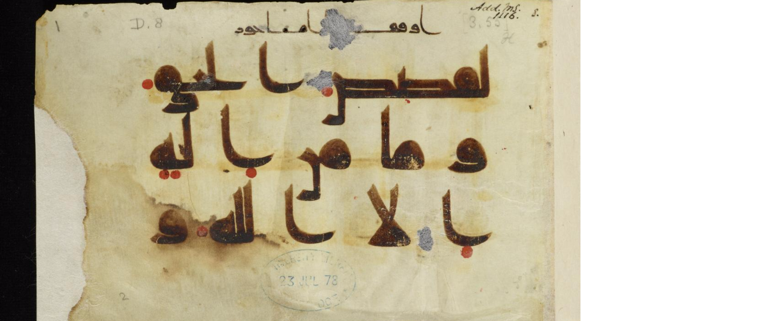
Islamic Illuminated Manuscripts

Slide 2
https://www.youtube.com/watch?v=wpsh7Qo8KLI

Slide 3
What IS an illuminated manuscript?
Because of the exalted position of the Qur’an in Muslim societies, special attention was paid to the production, illumination, decoration, and display of Qur’an manuscripts.
Due to its association with the written word of God, calligraphy is considered by Muslims to be the highest art form.
Luxuriously embellished Qur’an manuscripts are often placed on specially designed bookstands and prominently featured in mosques and religious schools.

Slide 4
What are components of Illuminated Manuscripts?
Codex= bound volume of parchment papers
Originally codices were longer vertically with later styles adopting longer horizontal widths
Parchment= animal skins that are treated and stretched
Binding sometimes in wood with tooled leather strips
Lined for calligraphic writing
Calligraphy VERY IMPORTANT to writing of text
Illumination: the addition of visual elements to provide structure and information

Slide 5
Illuminated Works and Arabic Language
Place of origin/date correlates with style of work: Calligraphy, Illumination, page layout and physical format
Text written from RIGHT to LEFT
29 letters=Semitic Family of scripts (Arabic, Hebrew, etc)
Almost ALL consonants: Vowels added later for easier reading
Because Muhammad received revelations in Arabic, the language is significant in Islam

Slide 6
Illumination
Beautifying= devotional act
Facilitate reading=Marked divisions of text
Designs in gold and colors, inspired by geometry, stylized plant life, and architectural motifs
Marked pages at beginning of text and end
The illuminated projections (ex. palmettes) used for explanation and/or emphasis
Illuminated Frames used as protective frame or emphasize a division within page
Illumination for marking verse
*Figural representations of Muhammad do exist. There are many debates on who and why people can or are represented visually in Islamic Manuscripts.

Slide 7
Bit of History on Illuminated Qur’ans
First Caliph to succeed Muhammad, Abu Bakr (632-4) had revelations written down in book form by Muhammad’s secretary, Zayd ibn Thabit
Used oral tradition and fragments written on stone, papyrus, parchment, camel bone, palm leaves and leather
20 years so an increase in demand with spread of Islam into Iraq, Syria, Egypt, N. Africa and Persia
3rd Caliph, Utman ibn ‘Affan, ordered canonized text, which is used to this day
Text arranged in 114 surahs= chapters
Excluding surah 1, surahs arranged from longest to shortest. NOT in sequence of revelation.

Slide 8
Wait...there’s more!
Shorter surahs from time in Mecca (hostile atmosphere)
Longer surahs from time in Median (embraced ideas)
All surahs (except for #9) begin with “Bismillah” = “In the name of God, the Merciful, the Compassionate”
“Hadith”= collected traditions on sayings & actions of Muhammed and followers
Qur’an + Hadith Influence ALL aspects of Muslim DAILY life
Qur’an is a primary text for teaching Arabic
Book is revered as Physical form of God’s words= devotion to book exemplified by hand crafted artistry

Slide 9
Other types of Illuminated Manuscripts
Poetry
Science
Mathematics
Literature
Medicine
Written in Arabic and illuminated, the artform helped unify diverse cultural backgrounds with Islam.

Slide 10
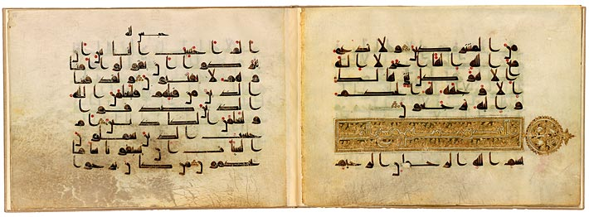
Check this out!
Qu'ran fragment, in Arabic, before 911, vellum, MS M. 712, fols 19v-20r, 23 x 32 cm, possibly Iraq (The Morgan Library and Museum, New York)

Slide 12
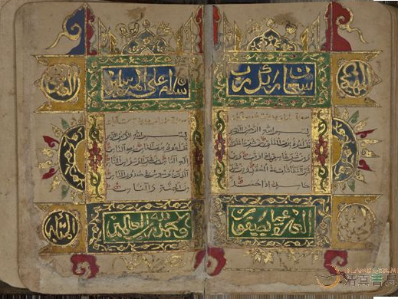
A complete Chinese Qur'an from Khanfu (Canton)Copied and illuminated by Abdul-Hayy Ibn Mahmud China, Khanfu (Guangzhou, formerly Canton)

Slide 13
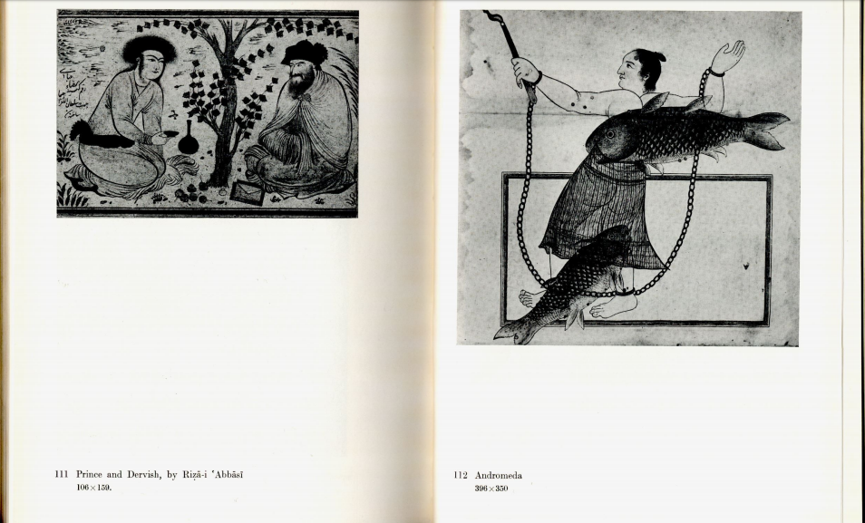

Slide 17
Contemporary
http://www.sandowbirk.com/paintings/recent-works/

Slide 18
Want to know more? Check out the online manuscripts and articles!
https://cudl.lib.cam.ac.uk/collections/islamic
http://www.asia.si.edu/research/symposia/art-of-the-quran/abstracts.php

Slide 19
RESOURCES
*background slide image: https://cudl.lib.cam.ac.uk/view/MS-ADD-01116/3
*Deroche, Francis. The Abbasid Tradition: Qur’ans of the 8th to 10 th Century ., Nour Foundation with Oxford University Press. New York, 1992.
*Baker, Colin F. Qur’an Manuscripts Calligraphy, Illumination, Design . The British Library. London, 2007
*https://www.library.yale.edu/neareast/exhibitions/exhibit20071.html
*http://exhibitions.kelsey.lsa.umich.edu/pearls/objects/quran.html
*https://www.khanacademy.org/humanities/ap-art-history/west-and-central-asia/a/folio-from-a-quran
*http://www.islambook.net/bbs/archiver/showtopic-1585-13.aspx
*http://islamic-arts.org/2012/the-qur%E2%80%99an/
IMAGES OBTAINED FROM texts: “Muslim Miniature Paintings from the XIII to XIX Century” Catalogue of the Exhibition by Ernst J. Grube, 1962 and The Topkapi Saray Museum: The Albums and Illustated Manuscripts, trasnlated, expanded and edited by J.M. Rogers, 1986.

