Slide 1
Session 1
The following four slides are for use with the Visual Thinking Strategy exploration of Islamic arts. The basic information and links for further information can be found under the notes tab on each slide.

Slide 2
What do you see? What do you notice? What is going on?
Notes:
Garden Gathering, tile panel, 1640-1650, attributed to Iran; Height 41 inches, Width 74 inches, weight 400 lbs.
http://www.metmuseum.org/toah/works-of-art/03.9c/

Slide 3
Notes:
Fragmentary Cenotoph Cover (Tomb Cover)
17th-18th century, Turkey, silk
http://www.metmuseum.org/toah/works-of-art/32.100.460/

Slide 4
Notes:
Bowl with Bahram Gur and Azada
Late 12th-early 13th century, ceramic, attributed to Iran
http://www.metmuseum.org/toah/works-of-art/57.36.2/

Slide 5
Notes:
Calligraphic Galleon
1766-1767, Turkey, ink and gold on paper
http://www.metmuseum.org/art/collection/search/454611

Slide 6
Session 2-3
The Mosque

Slide 7
The Sultan Ahmed Mosque The Baiturrahman Mosque

Slide 8
What similarities and differences do you find?

Slide 9
Great Mosque of Samarra, Iraq
Year 851
Spiral minaret is 171 feet tall
Was connected to the mosque by a bridge
Notes:
By IgorF - vlastni foto, CC BY-SA 3.0, https://commons.wikimedia.org/w/index.php?curid=3927819

Slide 10
Great Mosque of Xi’an
The largest mosque in China
Known as the Great Eastern Mosque
Decorated with Chinese and Arabic calligraphy
Features Chinese pagodas
Notes:
By chensiyuan - chensiyuan, GFDL, https://commons.wikimedia.org/w/index.php?curid=15734937

Slide 11
Session 4
Geometric and Arabesque Design

Slide 12
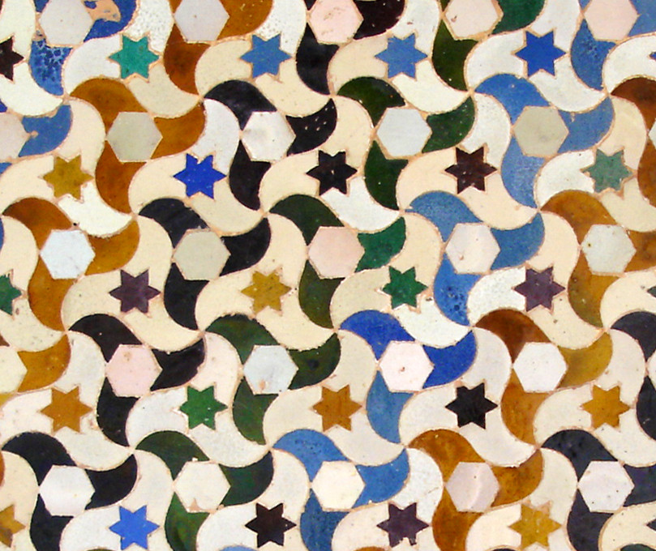
Mosque Decoration
Notes:
Left: By Guilhem Vellut from Vancouver, Canada - Jama Masjid in Fatehpur SikriUploaded by Ekabhishek, CC BY-SA 2.0, https://commons.wikimedia.org/w/index.php?curid=11968369
Right: By Dmharvey - Own work, CC BY-SA 3.0, https://commons.wikimedia.org/w/index.php?curid=1980257

Slide 13
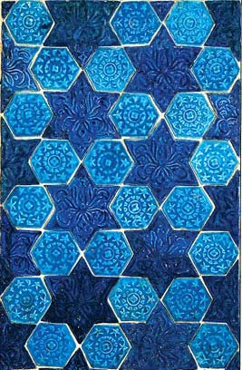
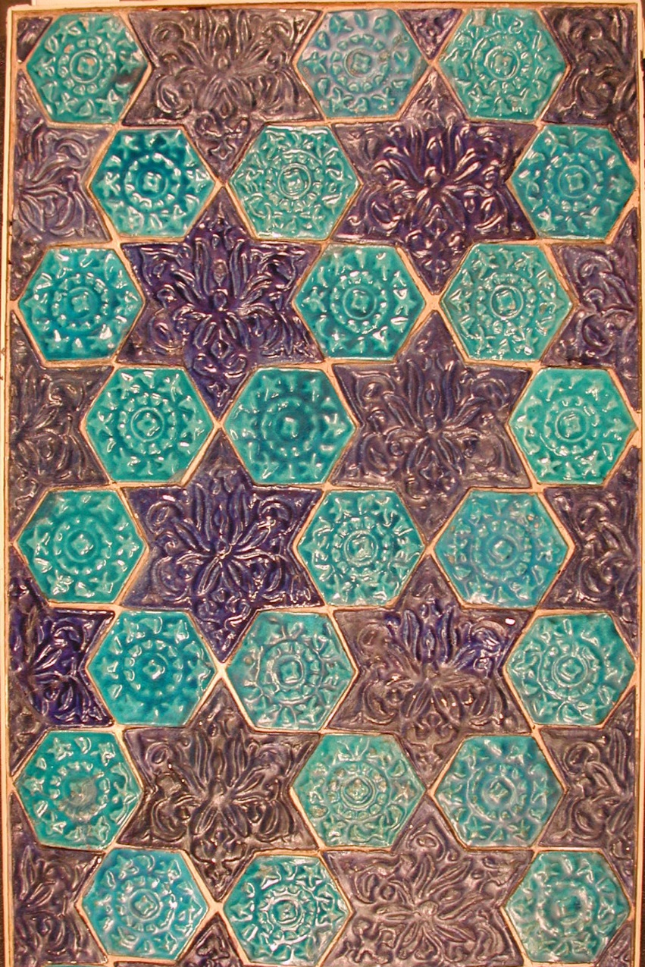
Geometric Design and Tessellations
Star and Hexagonal Tile Pattern
Late 13th-14th century
Probably from Iran
Notes:
http://www.metmuseum.org/art/collection/search/449137

Slide 14
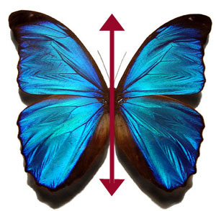
Symmetry and the Arabesque

Slide 15
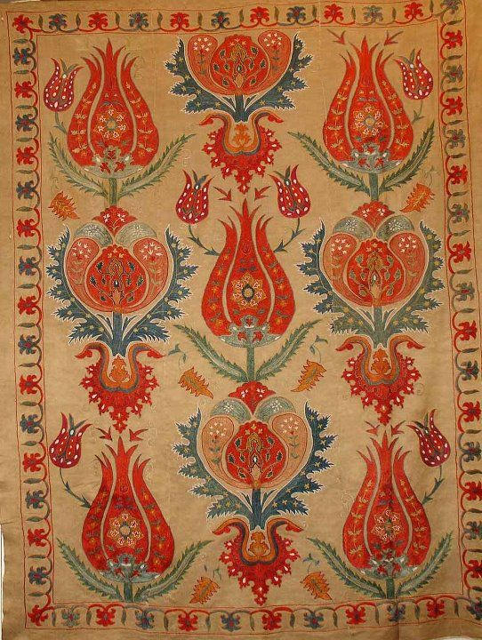
Notes:
https://s-media-cache-ak0.pinimg.com/originals/76/14/36/761436b65051a7573d46c935966b8a21.jpg

Slide 16
Session 5
Calligraphy

Slide 17
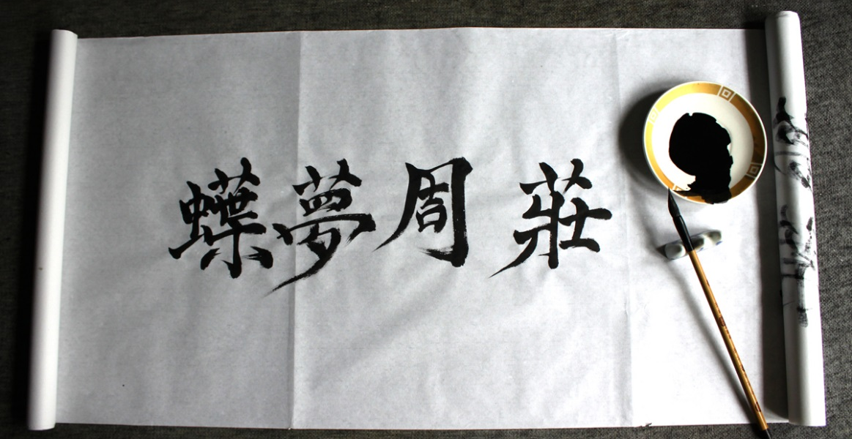
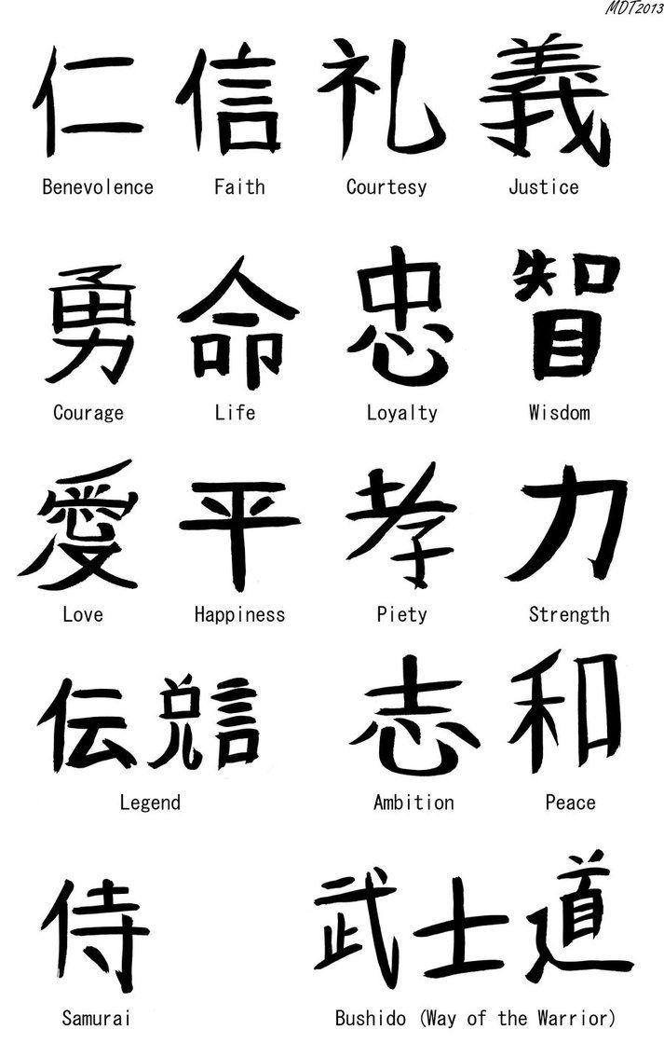
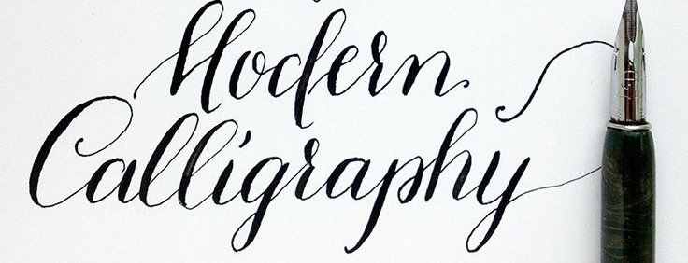
Chinese calligraphy
Old English calligraphy
Japanese calligraphy
Notes:
Different styles of calligraphy around the world…

Slide 19
Arabic Calligraphy as an Art Form
Calligraphy, from the Greek words kallos (beauty) and graphos (writing), refers to the harmonious proportion of both letters within a word and words on a page. While some of the best examples of calligraphic writing make this art form appear effortless, each letter and diacritical mark is the result of painstaking measurements and multiple strokes.
Calligraphy appears on both religious and secular objects in virtually every medium—architecture, paper, ceramics, carpets, glass, jewelry, woodcarving, and metalwork.
From The MetMuseum resource Art of the Islamic World, Unit 2: Arabic Script and the Art of Calligraphy
Notes:
http://www.metmuseum.org/learn/educators/curriculum-resources/art-of-the-islamic-world/unit-two/arabic-calligraphy-as-an-art-form

Slide 20
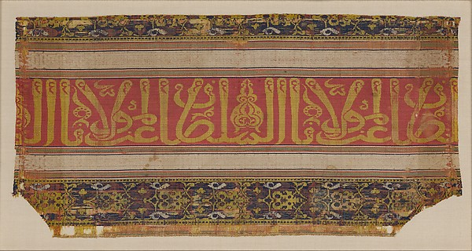
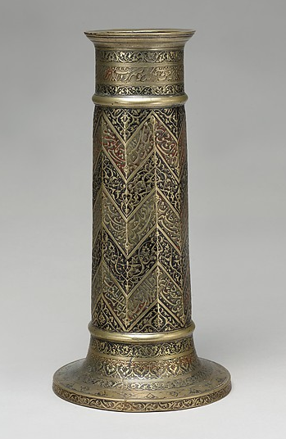
Islamic Calligraphy Examples
Notes:
Top left: Textile fragment, late 14th-early 15th century, Spain. See http://www.metmuseum.org/art/collection/search/447048 for more information.
Bottom left: Detail from “Portrait of Prince Danyal” late 16th century, India. See http://www.metmuseum.org/art/collection/search/451279 for more information.
Right: Engraved lamp stand with chevron pattern, AD 1578-79, attributed to Iran. See http://www.metmuseum.org/art/collection/search/448240 for more information.

